Slide 1
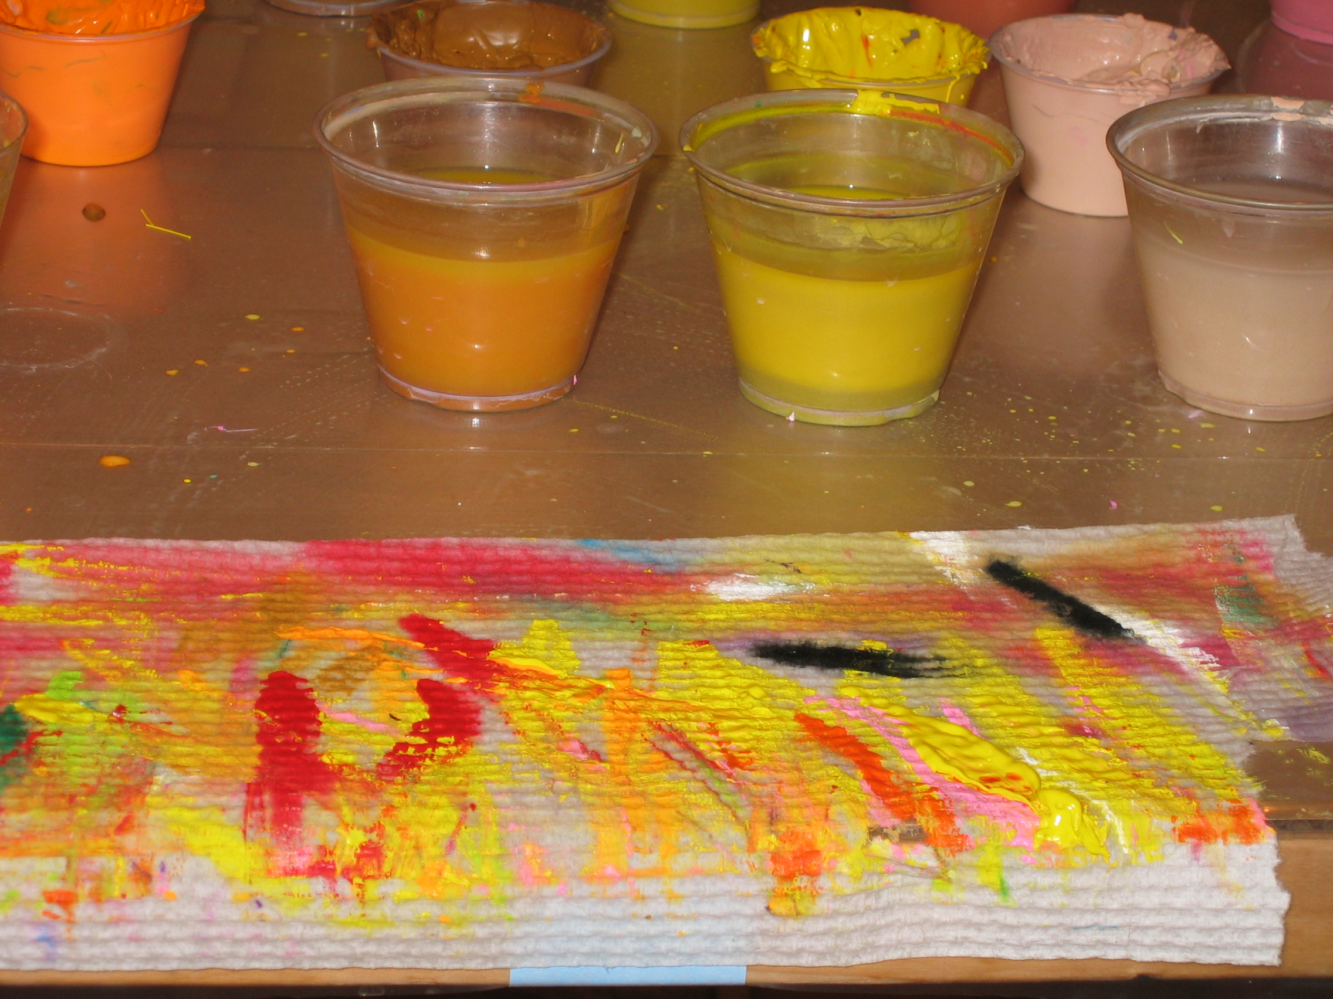
ART AS QUALITATIVE RESEARCH:
Considering the Possibilities
By:
Deborah Potts, Ph.D.
QRCA 2012

Slide 2
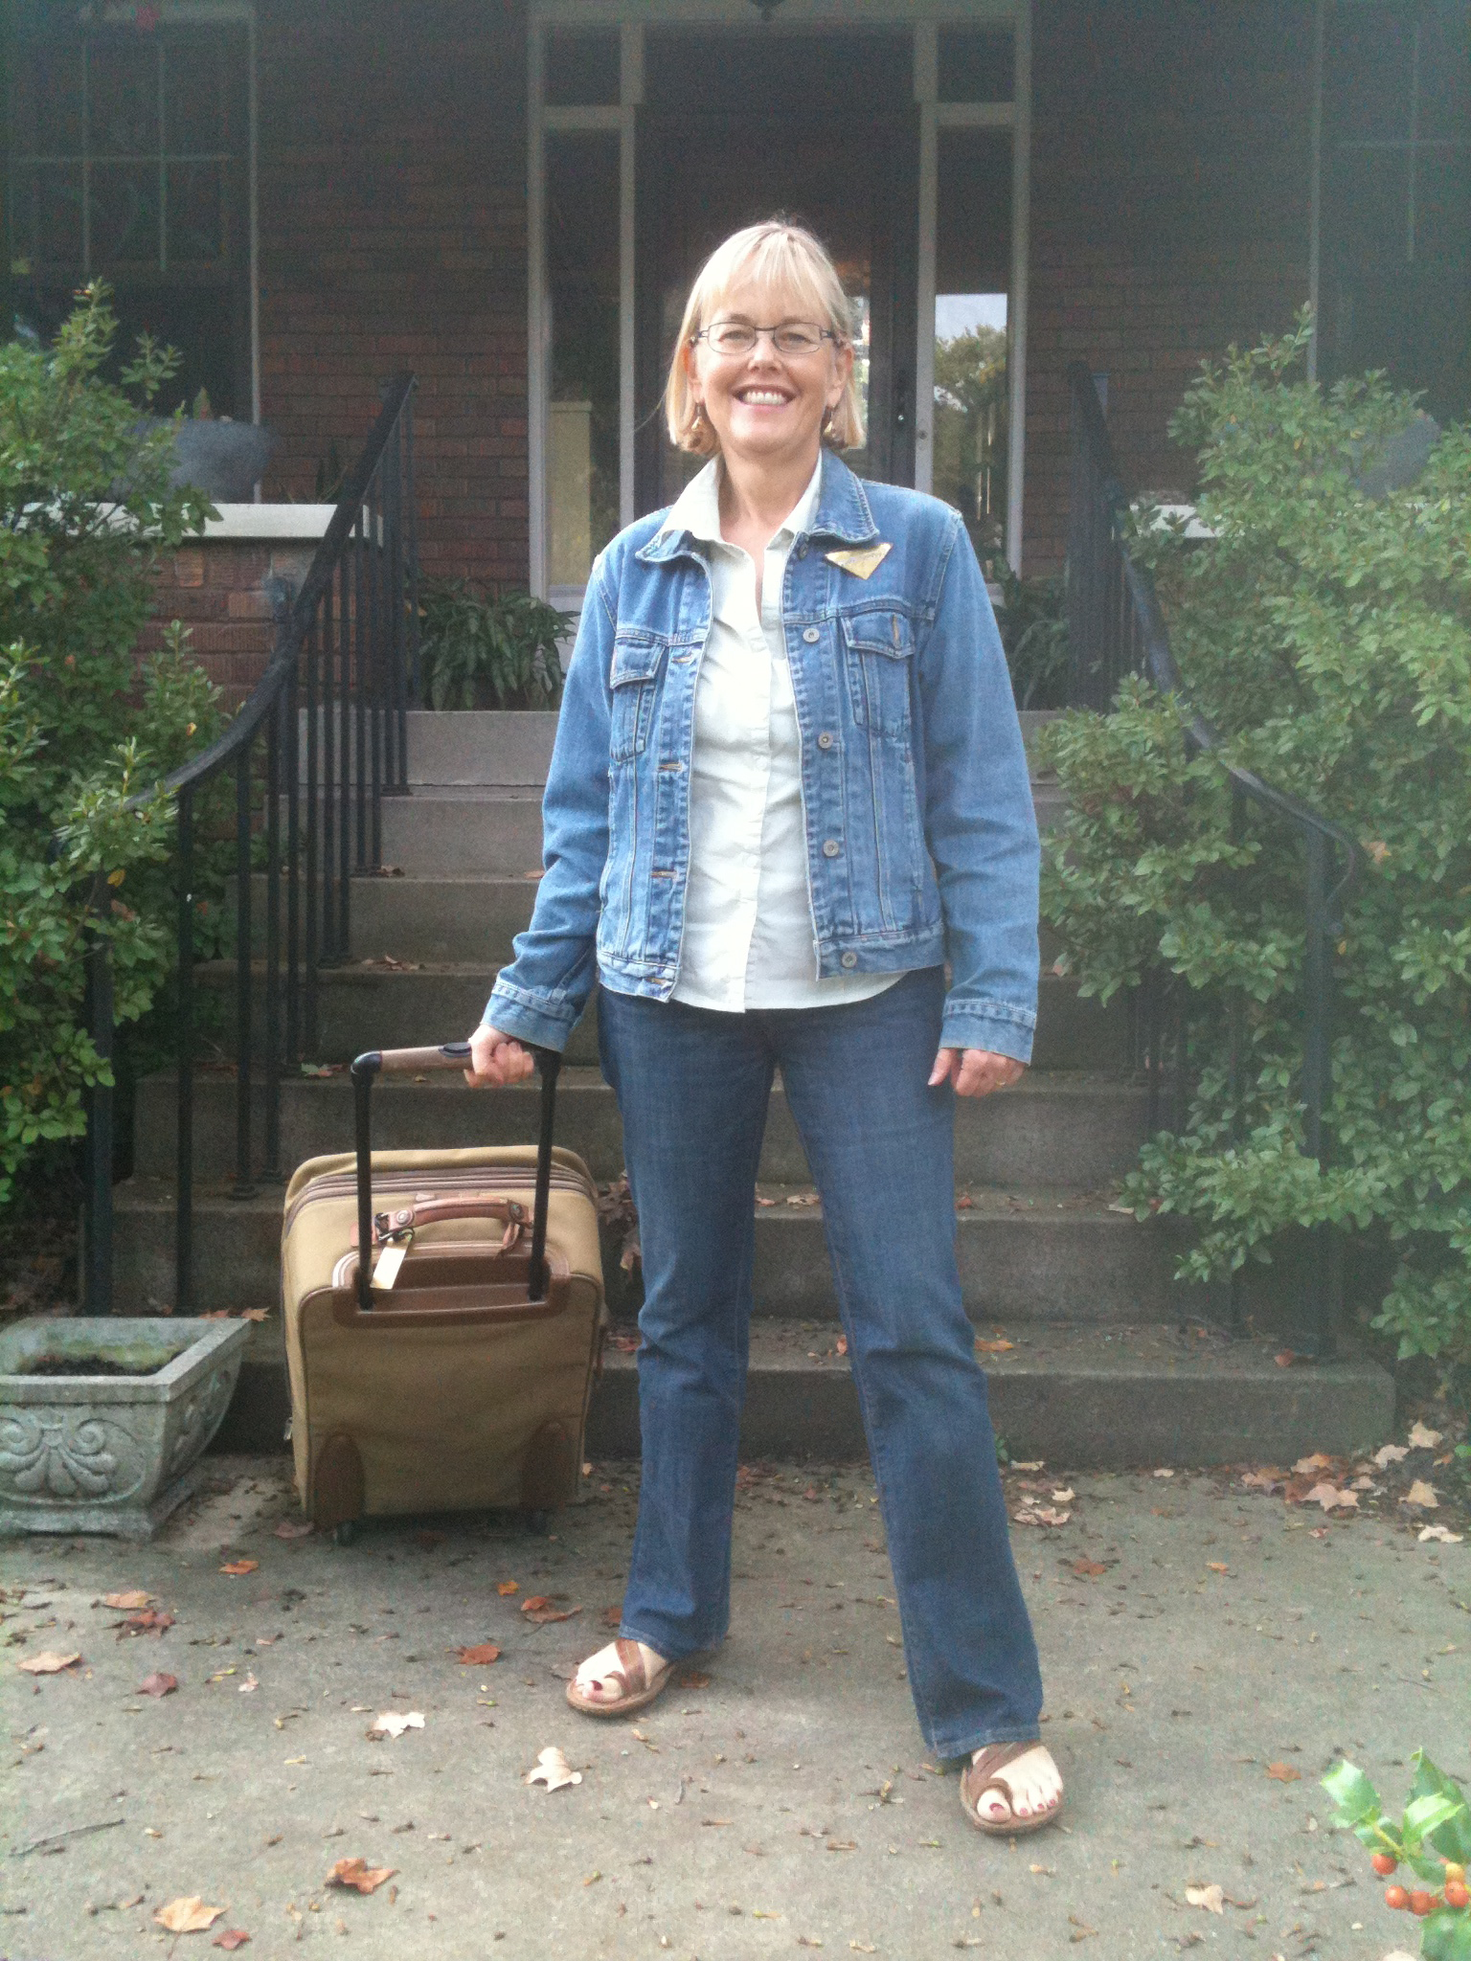
ON MY WAY TO AEA…

Slide 3
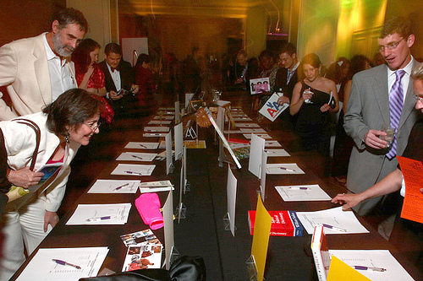
DISCOVERED A BOOK…

Slide 4
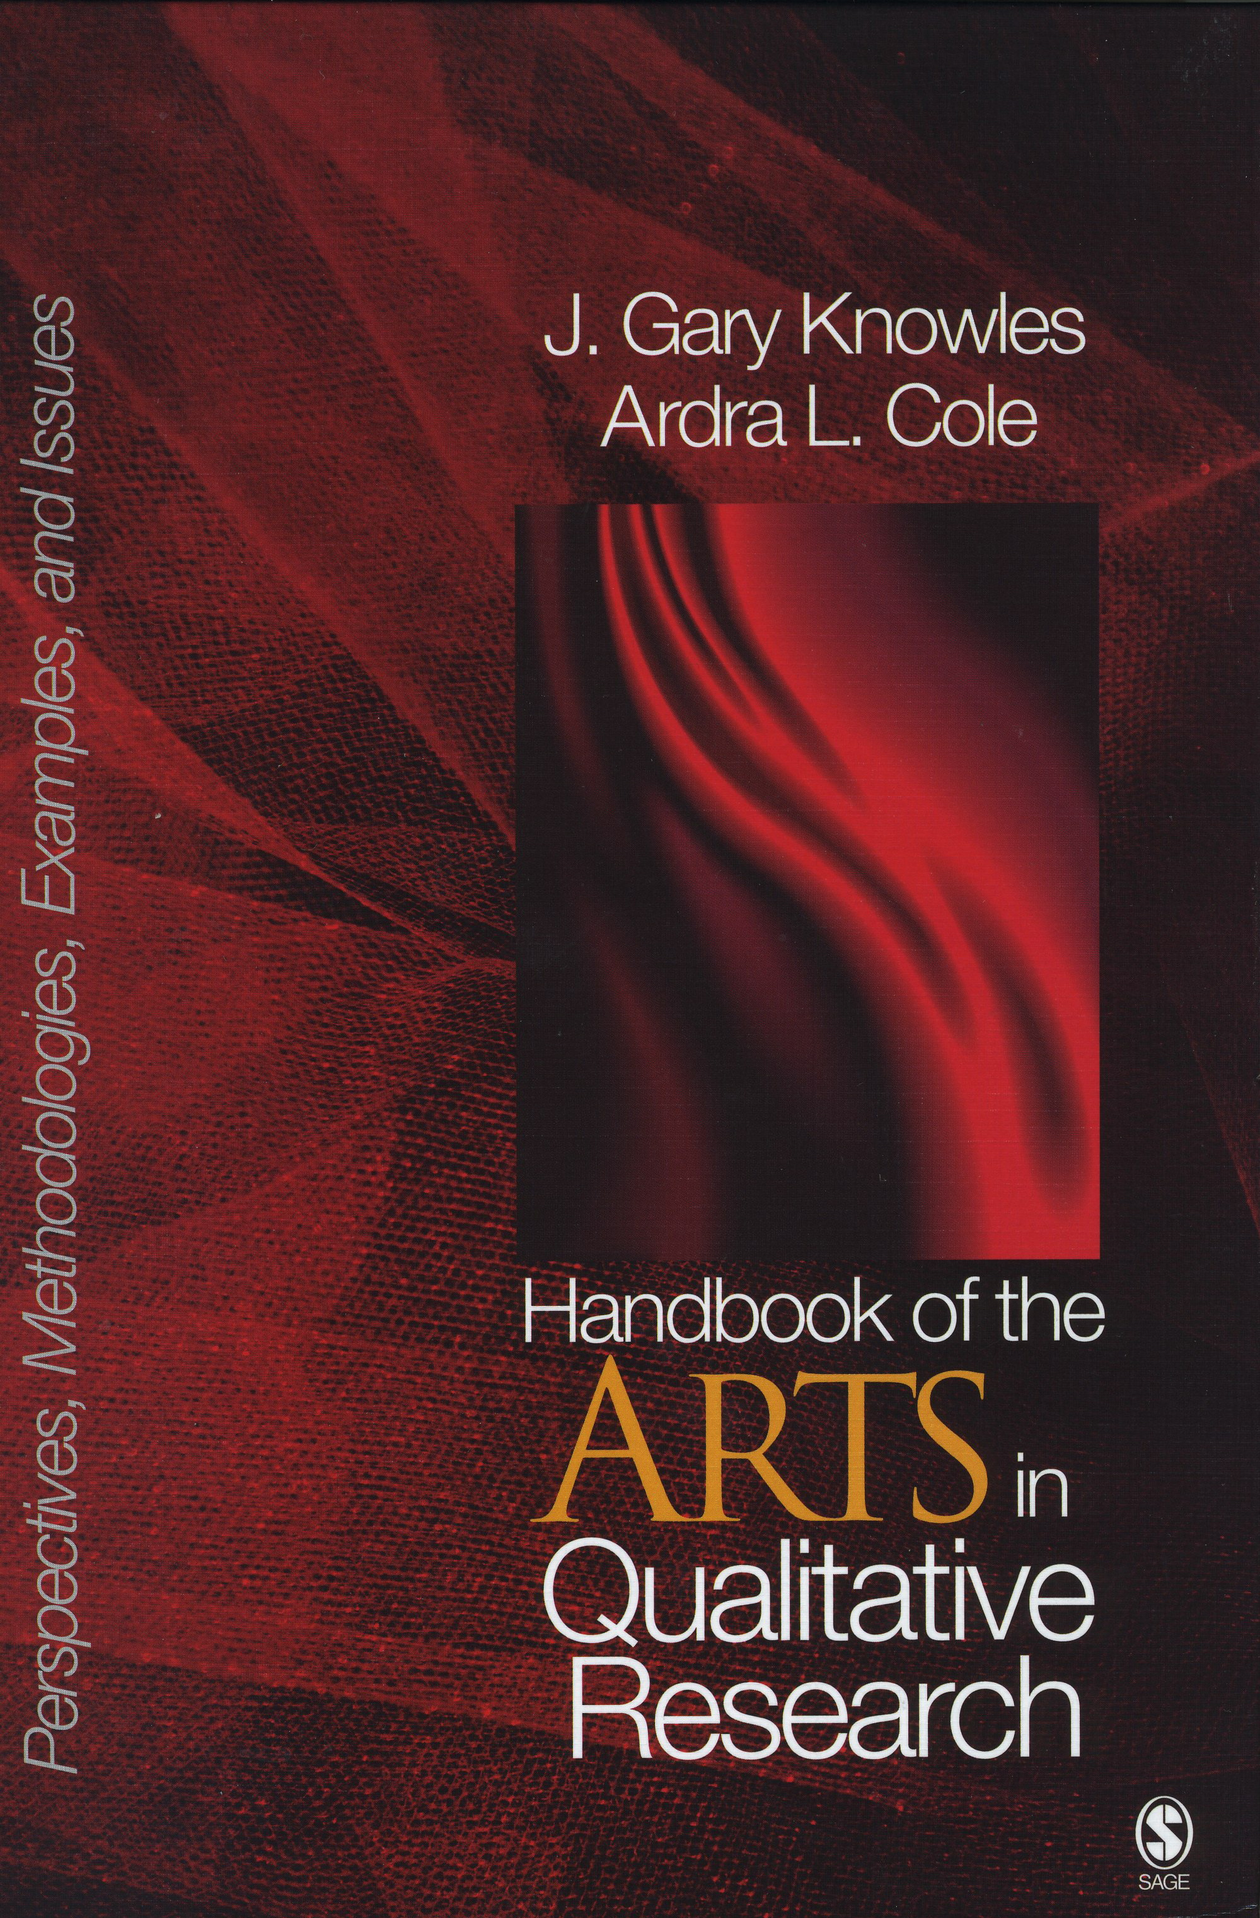
DISCOVERED A BOOK…

Slide 5
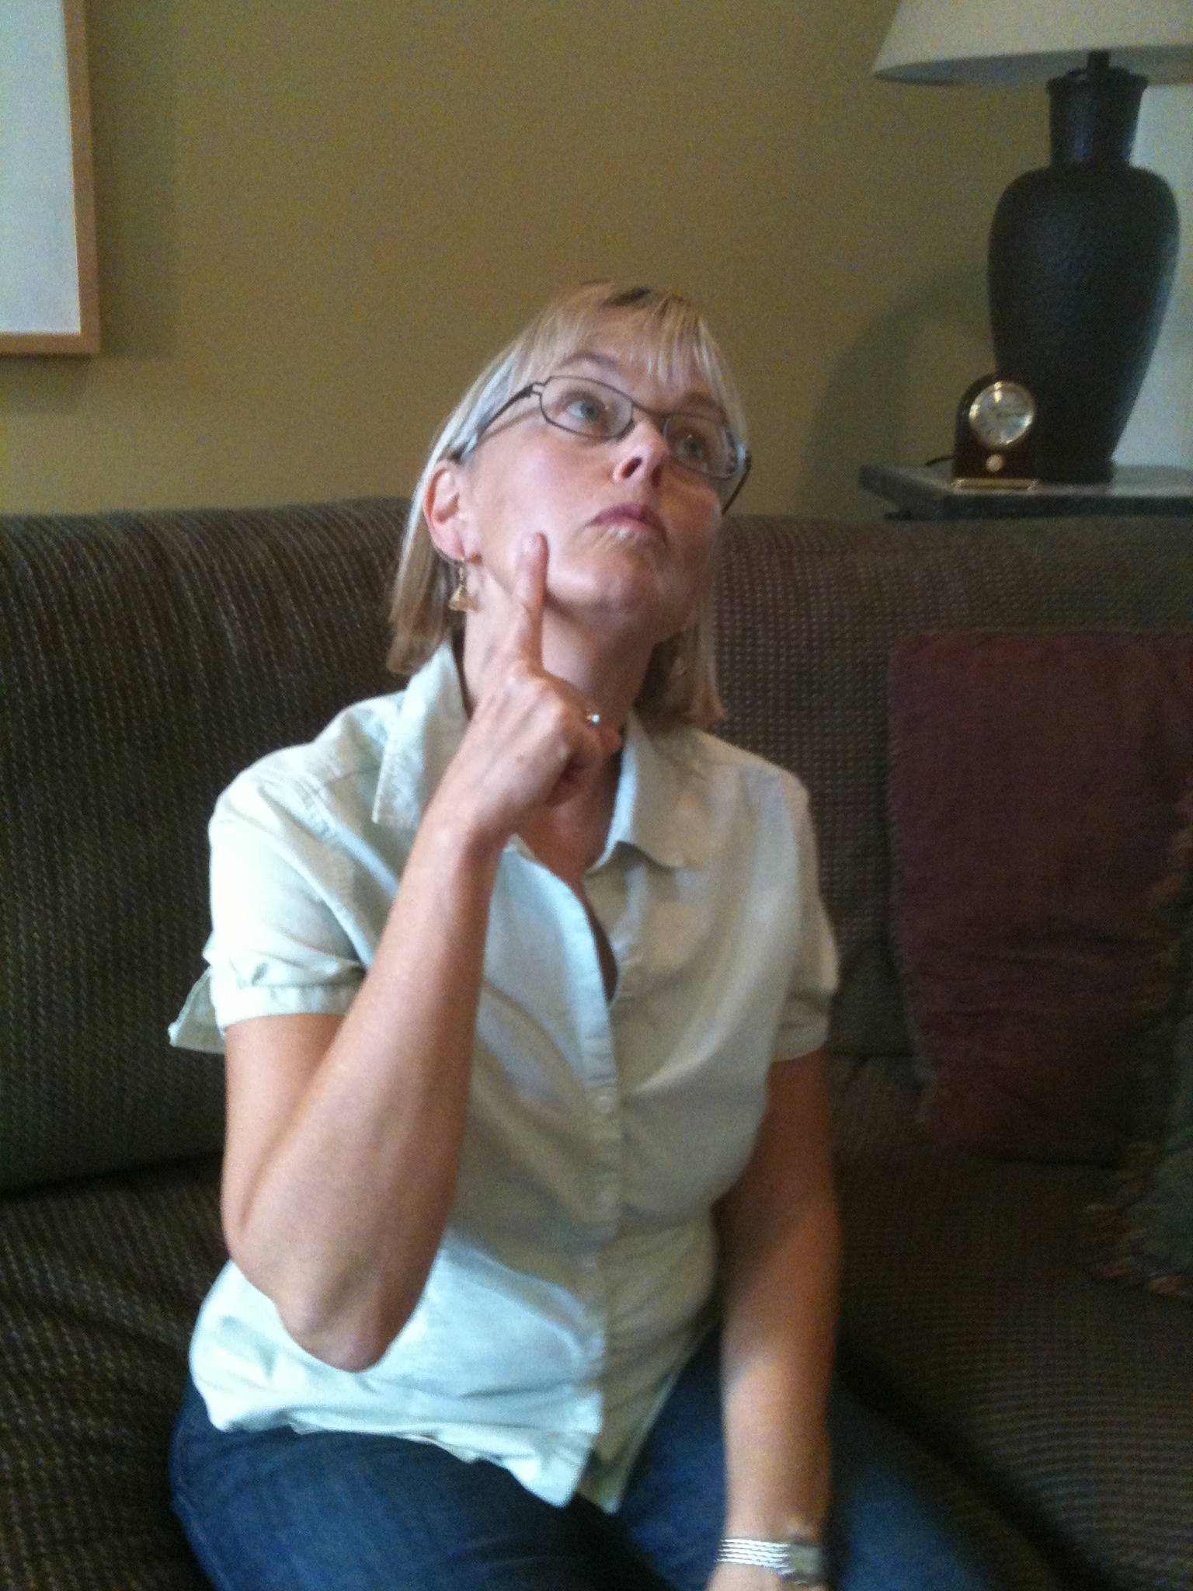
WHICH GOT ME THINKING…

Slide 6

We’re doing that!

Slide 7
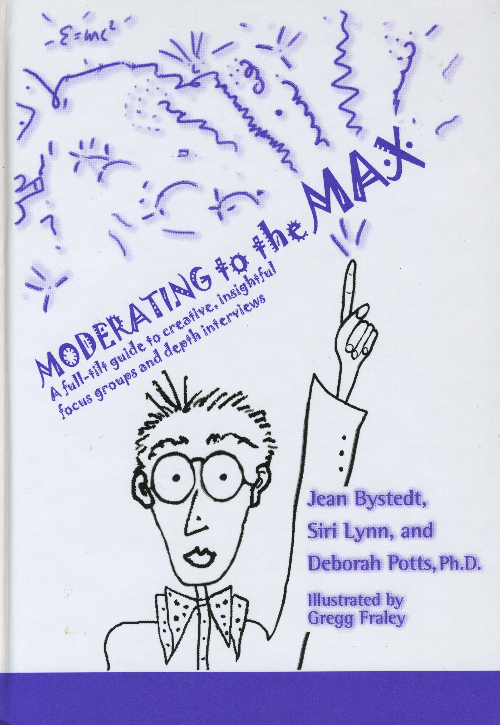
WE’RE DOING THAT!
Collage
Photos
Artistic stimuli as metaphor
  Pictures
  Music
Drawing
  Metaphorical drawing
  Draw the user
Story

Slide 8

And, is there more?
Notes:
In pursuit of rich understanding, helping consumers to access and discuss emotion, ultimately leading to insight. We get asked all the time – what’s next?
Overview: 1. talk a little about the book 2. my own springboarding 3. experience a few of these 4. brainstorming new ideas

Slide 9
TWO THEMES EMERGE…
Art as a way of knowing, discovering
⬇
Insight
Art as communicator
Notes:
Overview: talk a little about the book; my springboarding from it; and then do some brainstorming as a group

Slide 10
ART IN RESEARCH…
“[Art] opens the door for multiple forms of knowing … these [art forms] give us access to expressive possibilities that would not be possible without their presence.”
“What the artist is able to do is to provide a means through which feelings can come to be known.”

Slide 11
ART IN RESEARCH…
… addresses the qualitative nuances of situations…revealing a world one may not have noticed but that is there to be seen if only one know how to look.”
… generates empathy
… provides fresh perspective, offer new ways to perceive and interpret the world, making the “familiar strange and making the strange familiar”
… helps us connect with personal, subjective emotions, enabling us to discover our own interior landscape
“Art and Knowledge” by Elliot Eisner

Slide 12

HOW DOES THIS WORK
... As research tool??
Memory triggers
But more than that…
  STOP LOOK LISTEN!
Accessing the nonverbal
  “Right brained”
  Intuitive
  Creative
  Feelings
  Imagery
“Moderating to the Max”
By Jean Bystedt, Siri Lynn and Deborah Potts

Slide 13
HOW DOES THIS WORK
... As communicator?
Engages the audience
Generates empathy and understanding
Helps us remember
Communicates holistically
“Visual Images in Research”
By Sandra Weber
“Storytelling”
By Deborah Potts

Slide 14
Considering the Possibilities…

Slide 15

Artistic Tools
PUSHING THE BOUNDARIES OF OUR

Slide 16
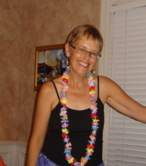
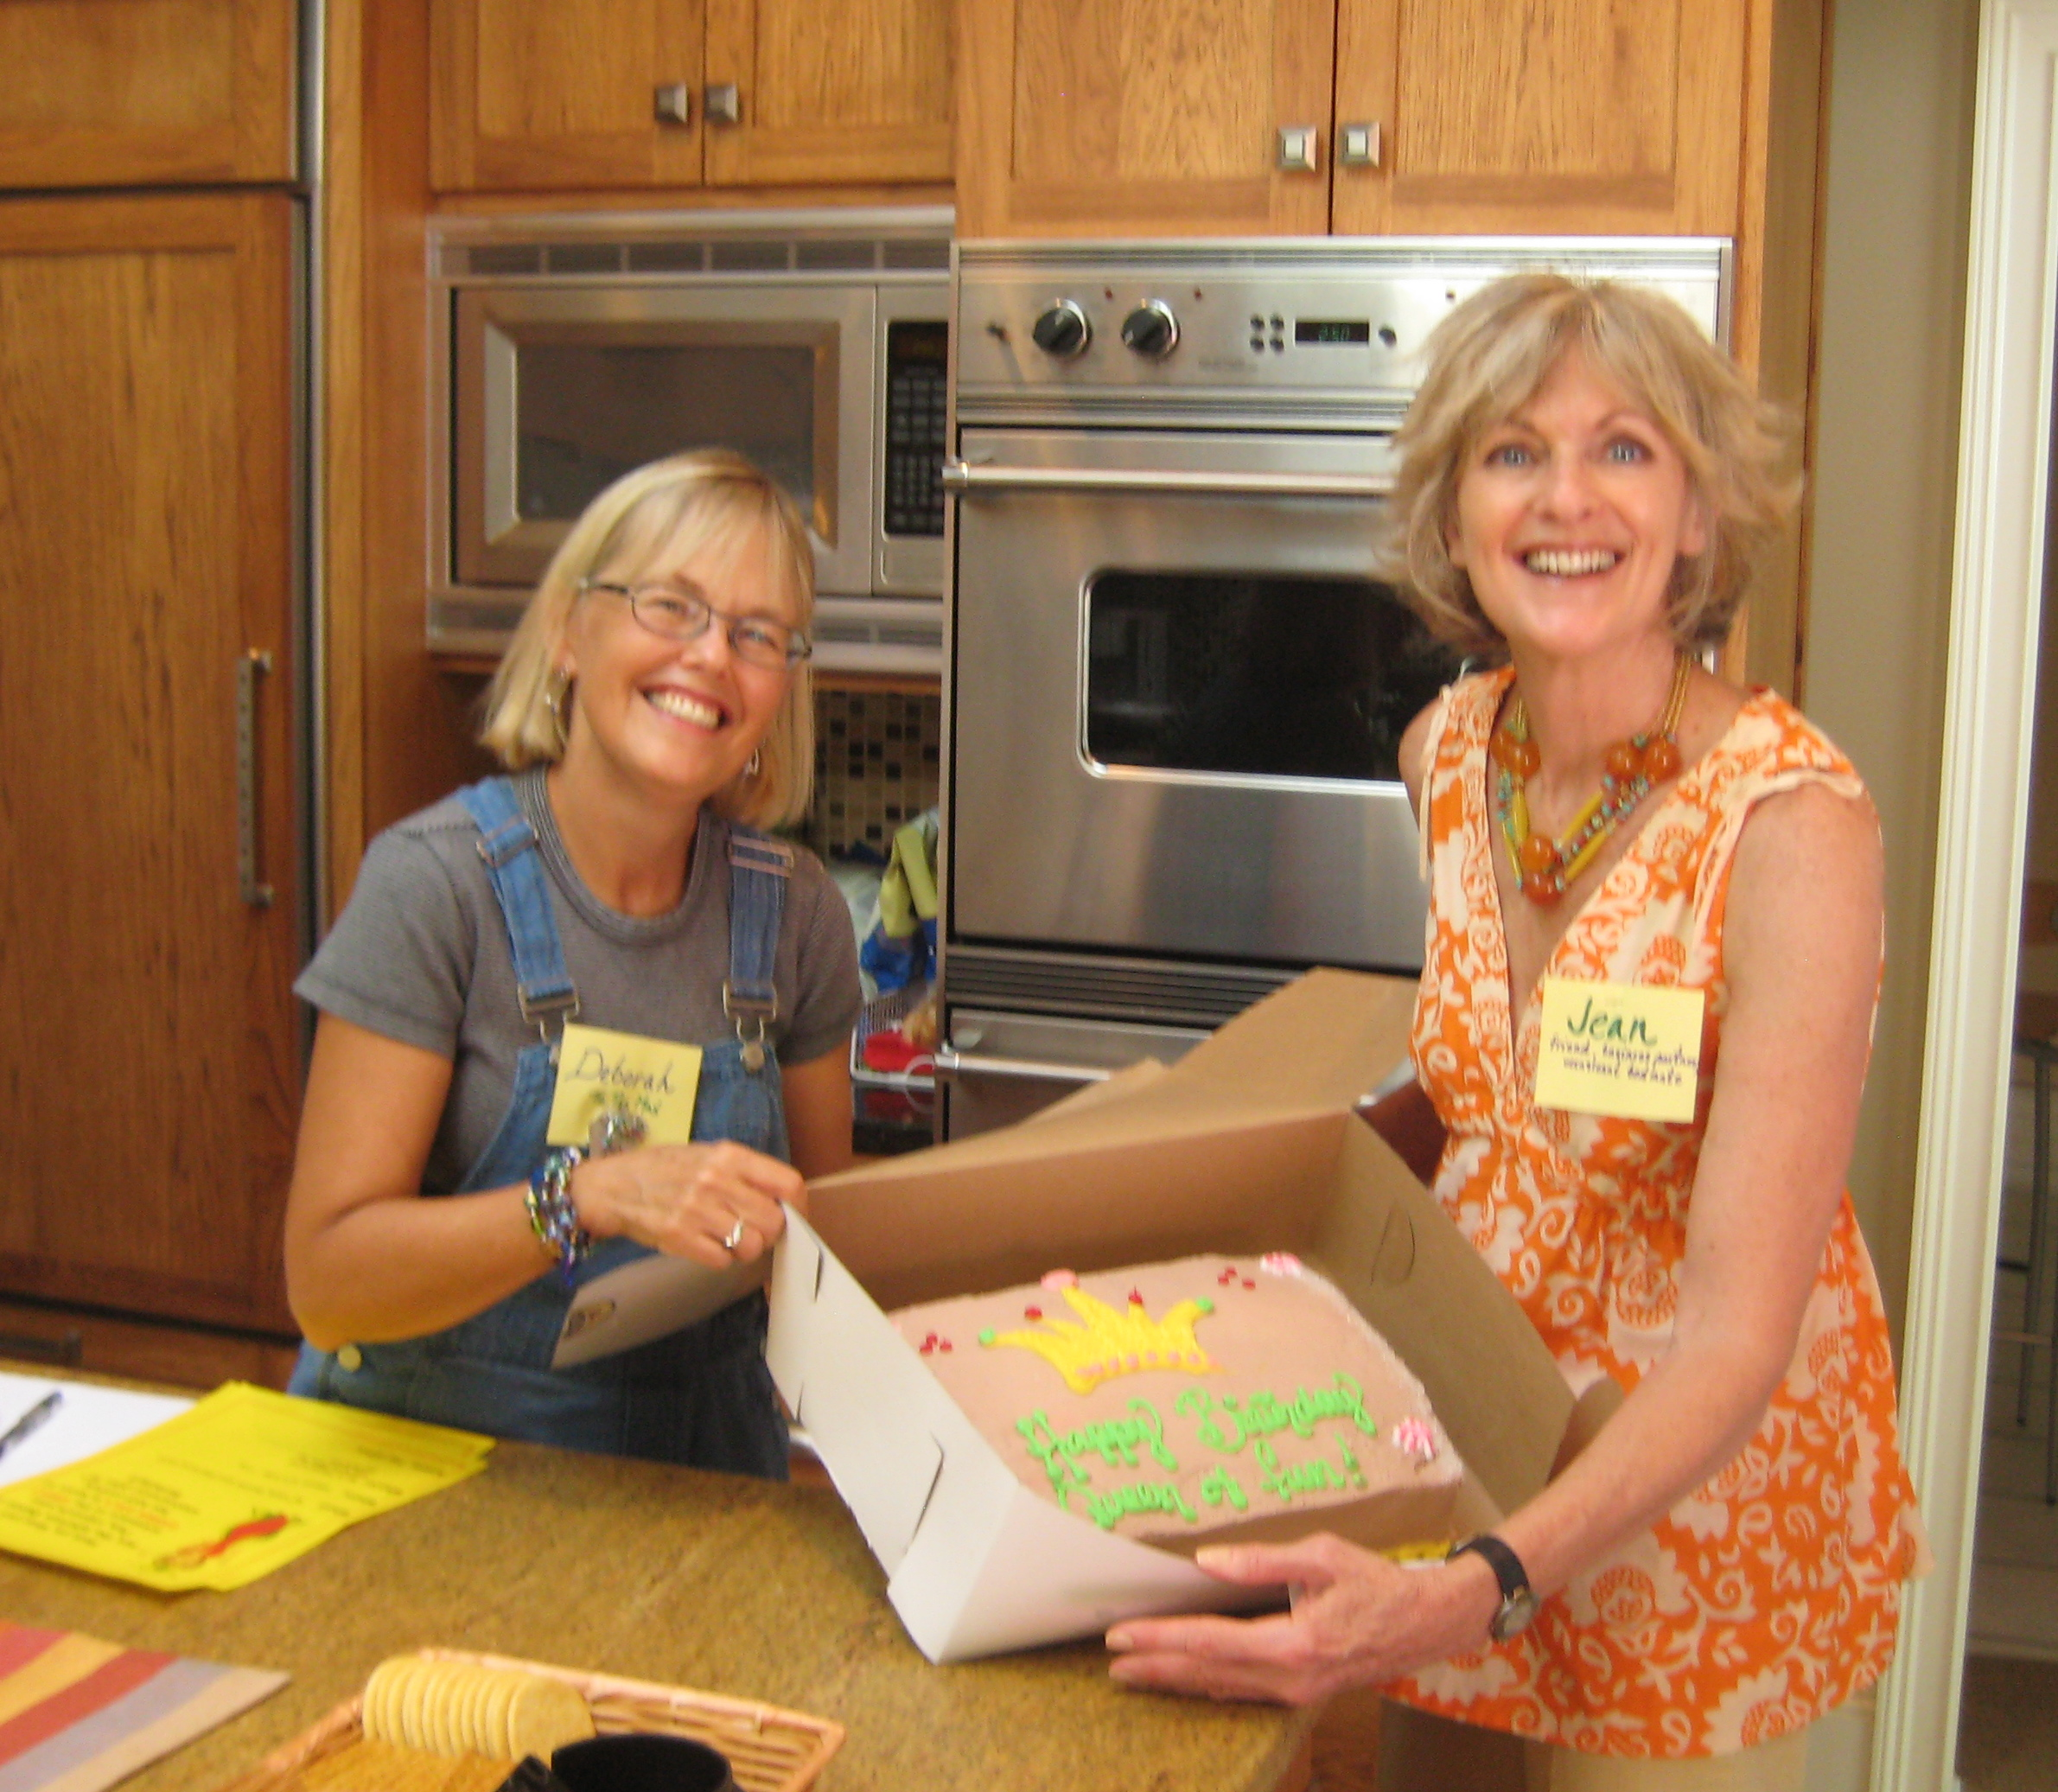
PUSHING THE BOUNDARIES: PHOTOS
Use existing photos
    Over time
    Before and after
Before
Now

Slide 17
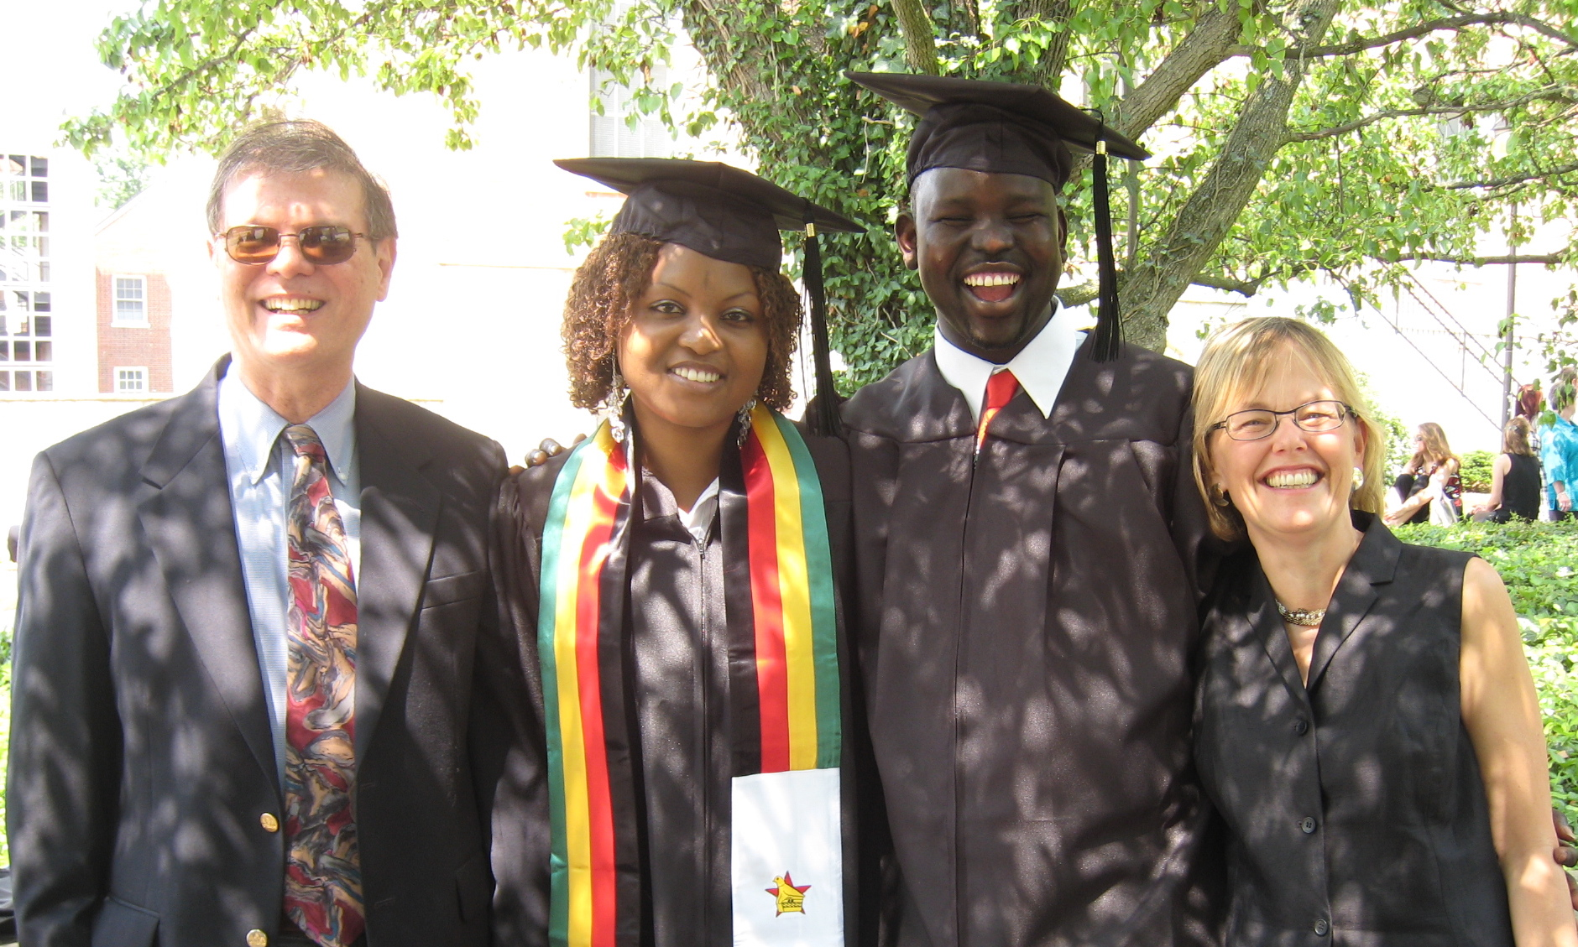
PUSHING THE BOUNDARIES: PHOTOS
Use photos as stimulus for rich discussion

Slide 18
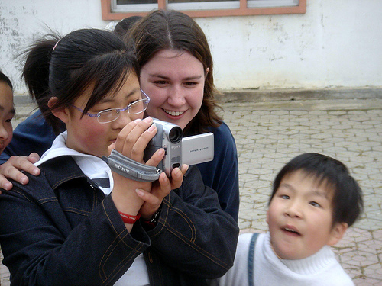
PUSHING THE BOUNDARIES: PHOTOS
Ethnographies
  Place the camera (video/still) in the hands of the participants

Slide 19
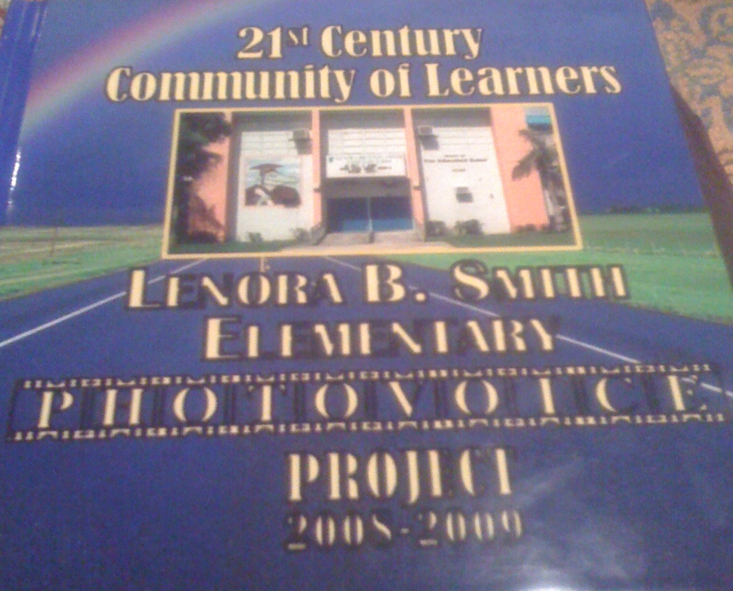

PUSHING THE BOUNDARIES: PHOTOS
Have participants create documentaries
  Film or photographic
  Solo or in partnerships (best friends, families, couples)
  Kids, teens, adults
  “Photo Voice”

Slide 20
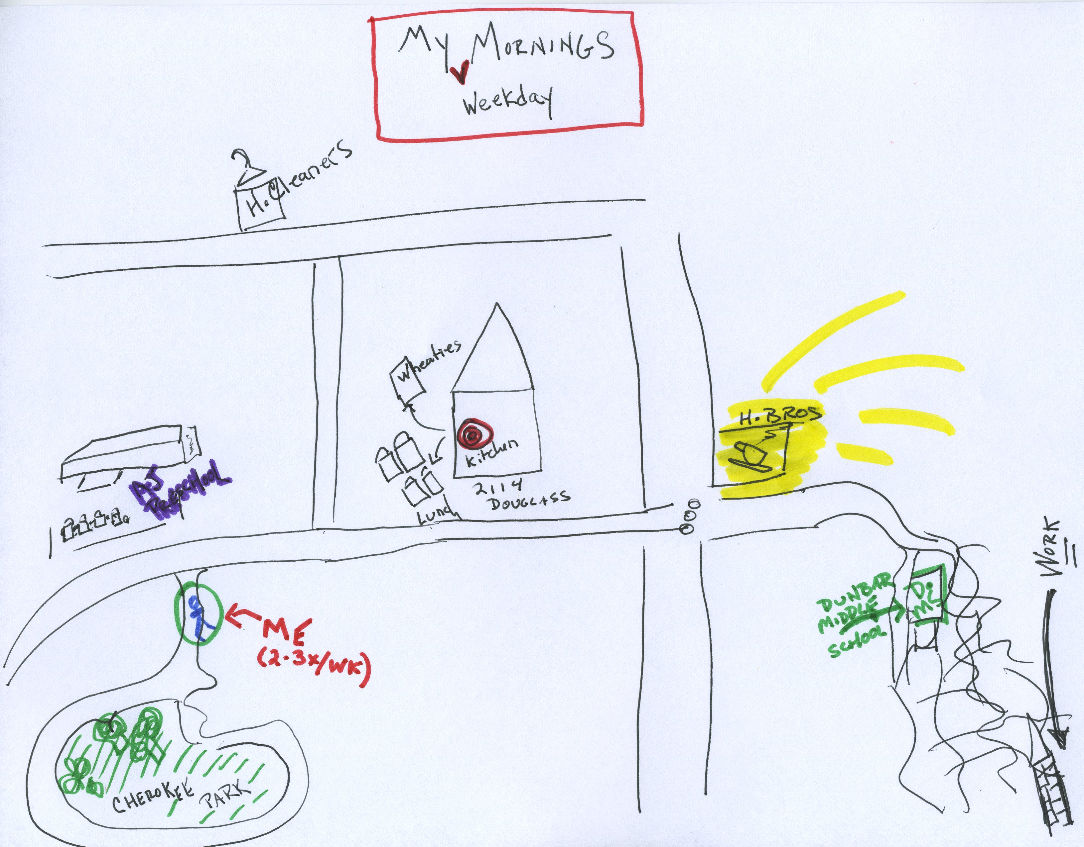
PUSHING THE BOUNDARIES: DRAWING
“Sense of place” map

Slide 21
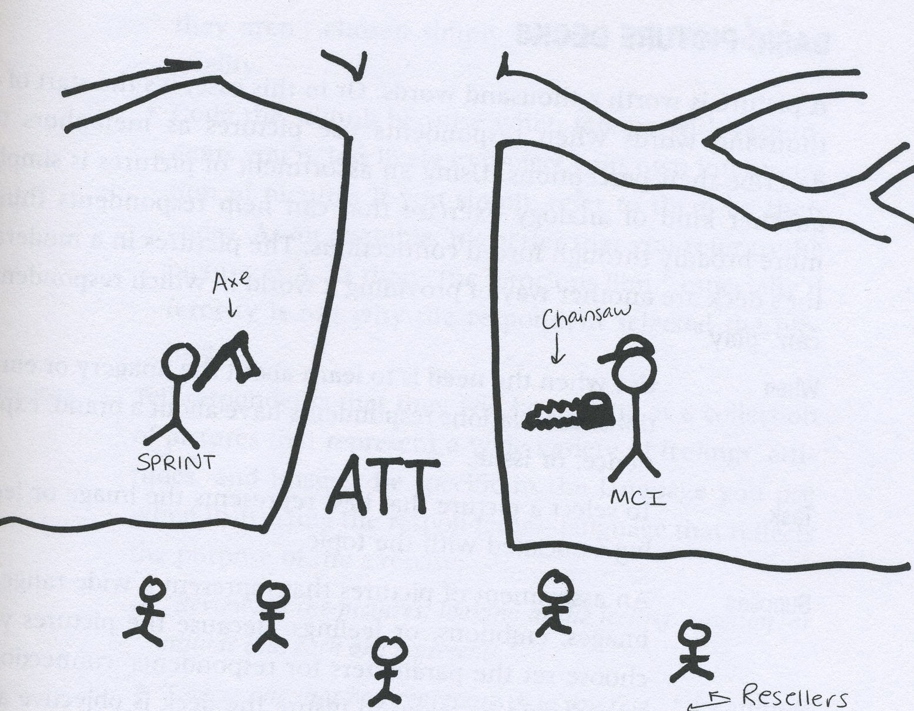
PUSHING THE BOUNDARIES: DRAWING
Metaphorical drawing as described in Moderating To The Max – ask for drawing, unaided

Slide 22
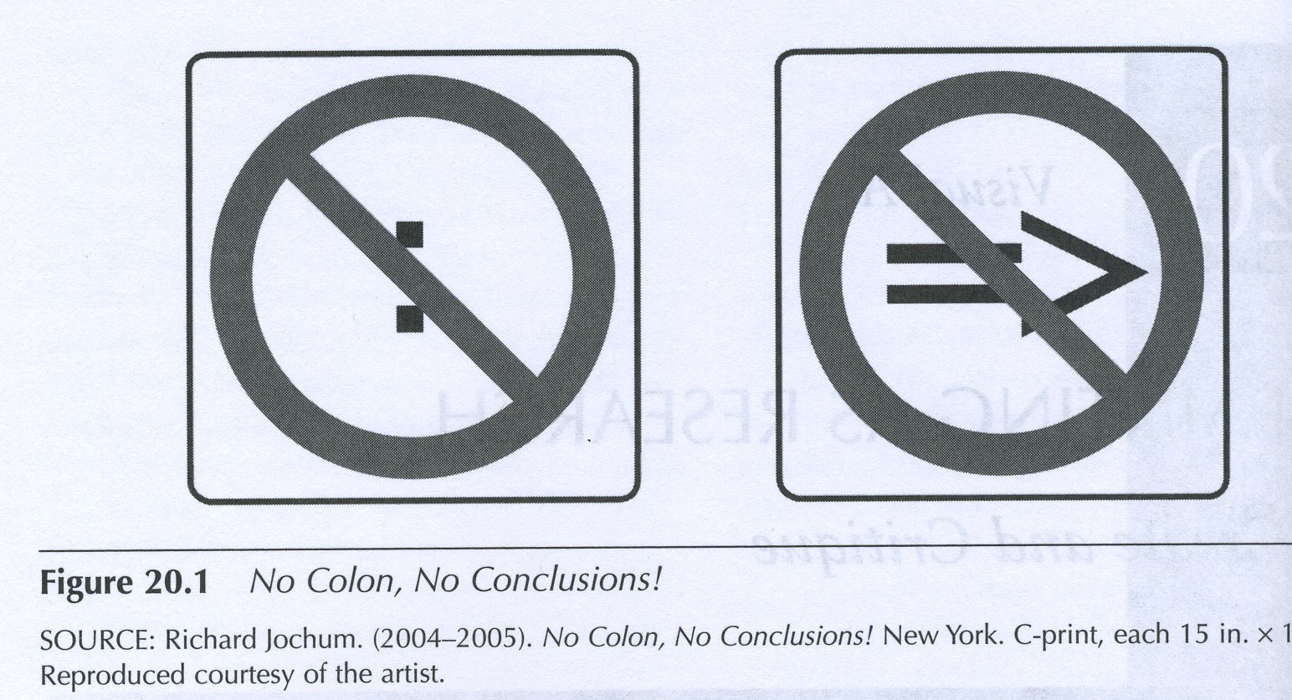
PUSHING THE BOUNDARIES: DRAWING
Consider metaphorical drawing as aided tool – provide the symbols

Slide 23
PUSHING THE BOUNDARIES: DRAWING
Think about your cell phone – how you use it, what you like about using it and what you don't like about it, how it adds to or detracts from your life, and any other feelings you have about it. I'm interested in your overall thoughts about what role your cell phone has in your life rather than specific features of your phone model.
Please create a picture using the shapes in the attached file that depicts your thoughts and feelings about your cell phone in your life. Then please tell me in just 2-3 sentences what your picture is about.

Slide 24
PUSHING THE BOUNDARIES: DRAWING

Slide 25
PUSHING THE BOUNDARIES: DRAWING

Slide 26
DRAWING
$
$
$

Slide 27
DRAWING
The pink rectangle represents my cell phone.
The bolt of lightening represents all the “shocks” I get with each incoming call:
The vibration in my pocket
The surprise at the ringtone going off when I thought I had silenced it
The buzz of a text message
The “boing” or “quack” of someone special’s ringtone
All the other symbols represent the different results of calls completed:
Enables me to do business, being available, making money
Allows me to connect with loved ones
Other connections that happen
Then there are the games I play, the videos I watch, and the books and music I listen to, the emails I can receive and send, and all the other un-phone-like activities I use it for. I created my own polka-dots to represent the “black holes” of entertainment my phone provides. Obviously my cell phone is much more than just a phone!

Slide 28
DRAWING
Friends & Family
Direction
Gravitational
Center
Work Life
All My Data
My cell phone bundles all my life activities together. It has all my important data, from work to family - with photos and videos, it literally carries memories around. It organizes my life, giving me directions as to meetings and locations. My life centers on my phone.

Slide 29
DRAWING
I view my cell phone as a way to stay in contact with loved ones across the country, through pictures, emails, texts, and calls. I do feel that it is an unstable way to manage my relationships with people as texts and brief conversations do not always convey everything correctly, and may be misinterpreted. The half circle bottom represents the instability, the yellow shape acts like a container that holds the heart and star that represent my relationships with other people.
Notes:
Comment: logical, way of organizing and expresses fairly conscious experience

Slide 30
Artistic INQUIRY
CONSIDERING NEW FORMS OF

Slide 31
CONSIDERING NEW FORMS…VISUAL
Topic: Think about times when you feel that you are living healthy; make a short list
Now focus on one

Slide 32
CONSIDERING NEW FORMS…VISUAL
Times when you feel that you are living healthy
Instructions:
  Set aside your usual thinking process. Sink into the experience you’ve identified. Using the art materials available on the table, create a [sculpture, drawing] that reflects your thoughts and feelings about this moment in time. How do you feel? What are key elements of the moment? What thoughts might you have? Are there concerns? Steer away from literal representations, and consider your experience
  PLEASE WORK SILENTLY (5 minutes)
(Forms: Play Doh, pastels, Legos®)
Notes:
Those drawing, use your nondominant hand

Slide 33
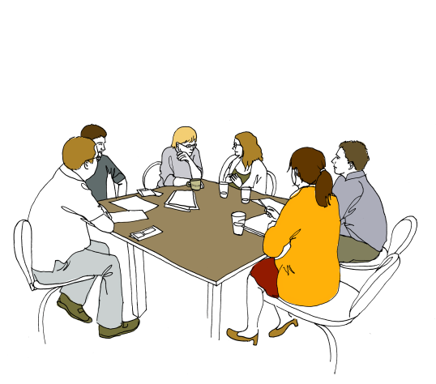
CONSIDERING NEW FORMS…VISUAL
Times when you feel that you are living healthy
Discuss content in small group
Discuss process – what worked? What concerns?
Thoughts to share with the group?

Slide 34
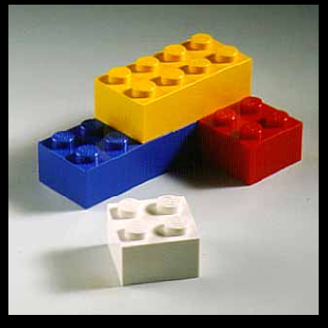
CONSIDERING NEW FORMS…VISUAL
Akin to Legos® Serious Play®
  Legos® used to explore organizational challenges
    Challenge
    Building – an individual, reflective process
    Sharing
  Think with the body
    Build visual reminders – “reduction of workload”
http://seriousplaypro.com/2010/08/19/lego-serious-play-open-source-brochure/
Notes:
Why does this work?
Something in the artistic realm, or is it the kinesthetics, that helps this work?

Slide 35
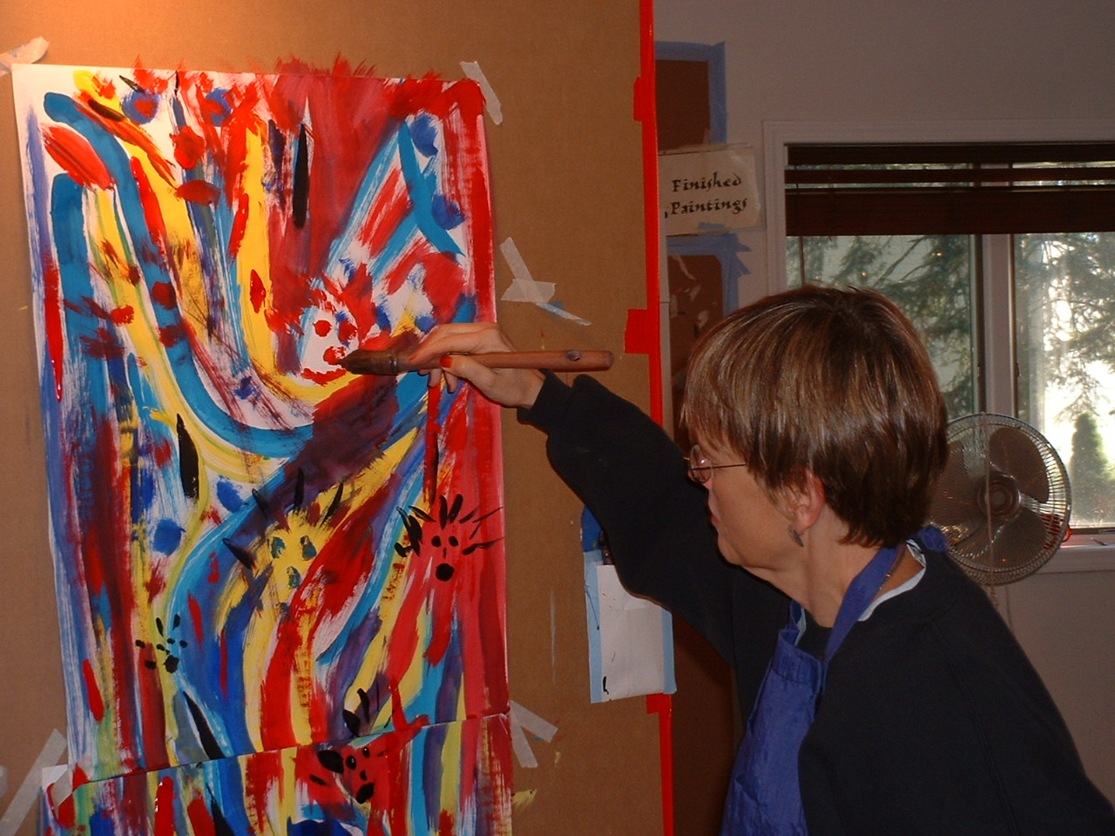
CONSIDERING NEW FORMS…VISUAL
Notes:
Among friends
The Painting Experience, Stewart Cubley

Slide 36
CONSIDERING NEW FORMS…VISUAL
Debrief
  Thoughts? Reactions?
  What other ways could we use visual media to tap emotion?
Notes:
Among friends
The Painting Experience, Stewart Cubley

Slide 37
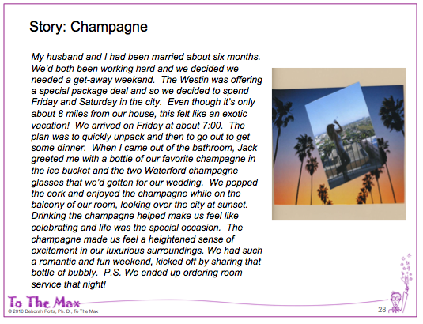
CONSIDERING NEW FORMS…
SPOKEN AND WRITTEN WORDS
We’ve always relied on verbal response …
  Quotes
    Embedded in reports
    Audio/video used in presentations
  More recently, storytelling
Notes:
NOW show Azur DVD

Slide 38
CONSIDERING NEW FORMS…
SPOKEN AND WRITTEN WORDS
Clearly…
  There is POWER in words!
http://www.youtube.com/watch?v=bvXTd6FVYi4

Slide 39
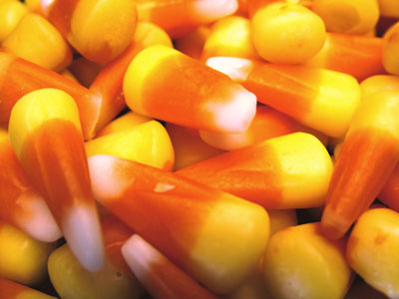
CONSIDERING NEW FORMS…
SPOKEN AND WRITTEN WORDS
Instructions
  Select a piece of candy
    That you enjoy
    With which you have a history

Slide 40
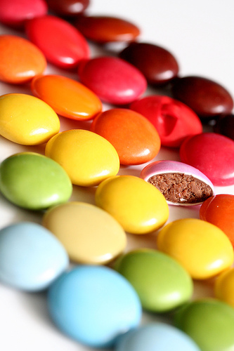
CONSIDERING NEW FORMS…
SPOKEN AND WRITTEN WORDS
Instructions
  As you eat it, take notes
    Describe what your experience
      Taste
      Texture
      Smell
      Appearance
      Sound
    Associations? Memories? Occasions?
    Likes? Benefits? Feelings?
  Rapid fire share at your table (2 min.)
Notes:
Share back with group, scribe

Slide 41
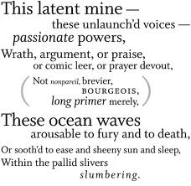
CONSIDERING NEW FORMS…
SPOKEN AND WRITTEN WORDS
Instructions
  Open envelope
  Write about your experience in form instructed, using the words you personally generated and springboarding from those words
Share
  Read your piece
  Discuss: why selected those words
  Discuss: how did this work as a tool?

Slide 42
CONSIDERING NEW FORMS…
SPOKEN AND WRITTEN WORDS
Debrief
  Share highlights
  New thoughts?
    How use?
    Other ideas for tapping the power of words?

Slide 43
What Else???

Slide 44

CONSIDERING NEW FORMS…
VERBAL + VISUAL
Autoethnography
  Autobiographical ethnography
  Focuses on the writer’s experience
  Example: ethnographer described her experience of researching a medical clinic in a tribal community through written word and her own painting

Slide 45
CONSIDERING NEW FORMS…
VERBAL + VISUAL
Autoethnography: How could this be used?
  Train participants to do their own ethnography, then come to central location and discuss
  Clients do ethnography, then come together to debrief
  Client team debriefs ethnographic experience using an art form, e.g. painting
  WE do an authoethnography – regarding use of art in qualitative research!
Notes:
USING PHOTO/VIDEO, KIDS DRAWINGS… ETC.

Slide 46
CONSIDERING NEW FORMS…
VERBAL + VISUAL
Interpretative biography
  A montage of moments, biographically meaningful events or moments in a person’s life
Multimedia Montage … can add a performance element
  Images, dramatic readings, sound
  Artifacts, metaphors, sketches, paintings
  Example: to explore the experience of Alzheimer’s Disease
Notes:
Montage – tailored to a topic – e.g. oral care

Slide 47
NEW IDEAS FOR Artistic INQUIRY
BRAINSTORMING

Slide 48
CONSIDERING NEW IDEAS…BRAINSTORM
Brainstorm
  New tools, based on art forms given to you
  Long list

Slide 49
DIVERGENT & CONVERGENT GUIDELINES
Divergent Guidelines
(Brainstorming)
Convergent Guidelines
(Selecting)
Defer judgment
Strive for quantity
Seek wild options
Combine and build on other ideas
[Thanks to Kitty Heusner for references]
In Applied Imagination (1963) by Alex Osborn and in Visionizing (2004) by S.J. Parnes.
Be deliberate
Check your objectives
Be affirmative
Improve your ideas
Scott Isaksen and Don Treffinger in Creative Problem Solving: The Basic Course (1985)

Slide 50
CONSIDERING NEW IDEAS…BRAINSTORM
Brainstorm
  New tools, based on art forms given to your table
  Long list
Choose one to develop
  Instructions
  When to use, with whom
  Materials needed
Report back
Notes:
Pair up in development? Write on easel. Gallery walk

Slide 51
What Else???
Notes:
Dance, movement? Naysayer … how to get client or respondents to play?

Slide 52
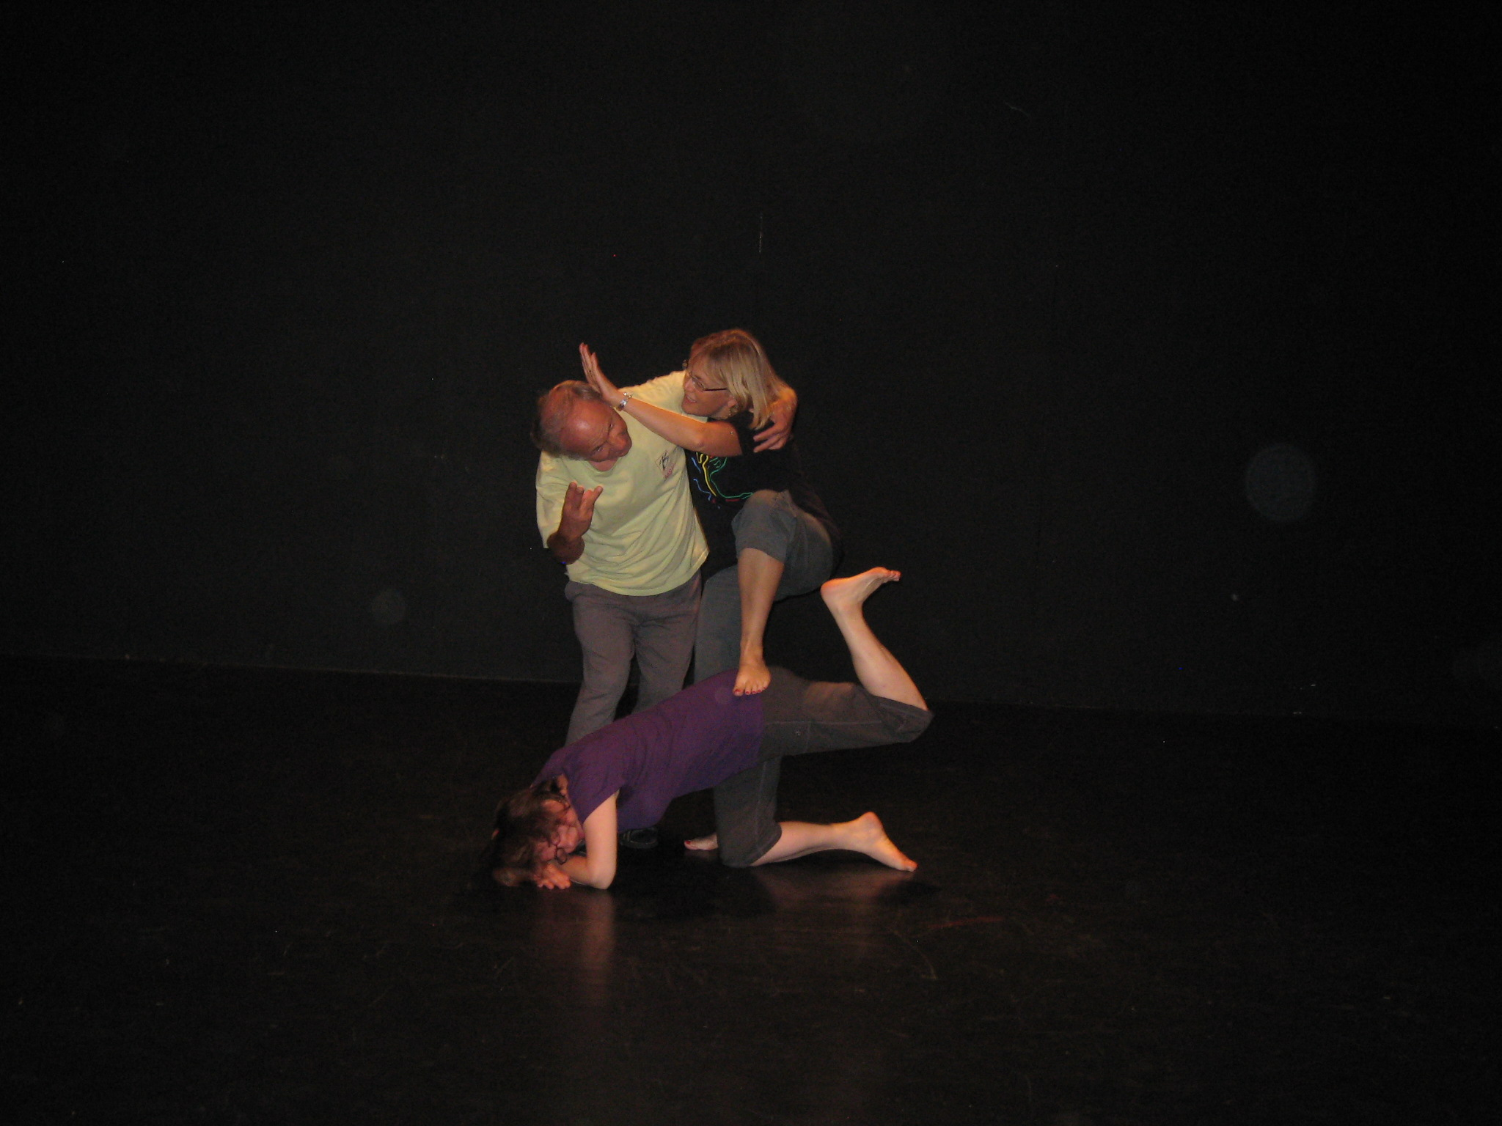
DANCE/MOVEMENT?

Slide 53
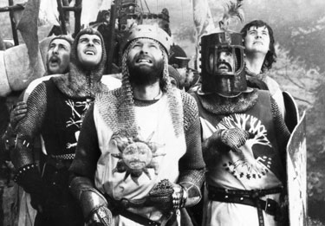
THE HOLY GRAIL
Exploring the non-rational,
In search of insight

